Slide 1
A Project by : Gurudas Premdas Chavan (2021BCS037) Pravin Pralhadrao Narwade (2021BCS047) Rahul Pramod Chafle (2021BCS061) Under The Guidance Of : Ms Misha Nihalani Mr. Rupesh Sonkamble
COURSE MANAGEMENT SYSTEM

Slide 2
CONTENTS
Abstract
Research Problem and Solution
E-R Diagram
Use Case Diagram
Modules Used
Admin Side and User Side Interface
Functionality
Technology Used
Conclusion & Future Scope

Slide 3
ABSTRACT
After the covid-19 outbreak, the world is moving towards an online environment so to provide a proper platform for students, we have developed a web-based platform which integrates all the modules and functionalities into a single system that can be handled by the administrative head (admin) and accessed by students. Our online course management system makes the process of teaching and learning easy and seamless for the students.
Objectives :
Step towards paperless environment.
Step towards interactive teaching environment.
To create a communication bridge between faculty and students.
Continuous tracking of academic growth of student.
To provide a platform for notes and assignment sharing

Slide 4
Problem Statement
In traditional educational settings, the management of academic courses often involves manual and time-consuming processes, leading to inefficiencies and challenges for administrators, instructors, and students.
Solution
By implementing this comprehensive Course Management System, educational institutions can expect to streamline administrative processes, enhance communication and collaboration, and leverage data for continuous improvement in the quality of education provided to students. The solution aims to create a more efficient, engaging, and technologically advanced educational environment.
Keyword: Course, System, Student, Management, Session.

Slide 5
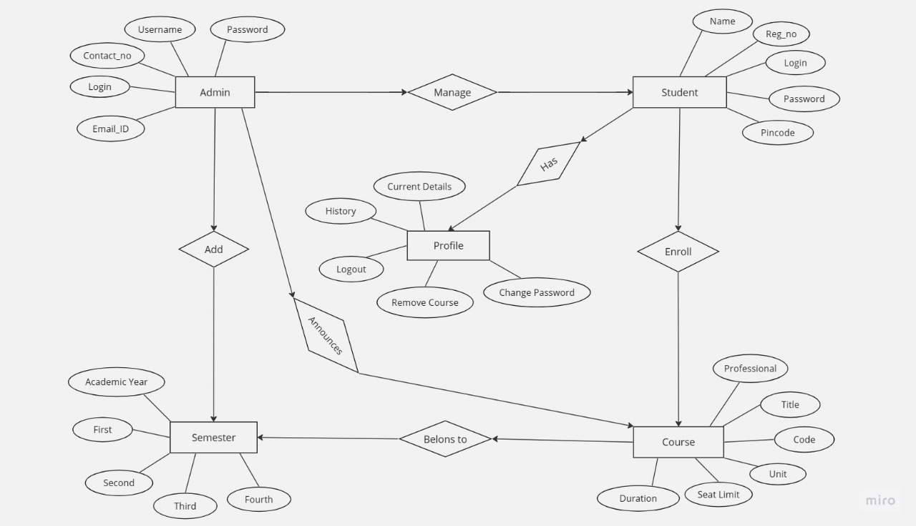
E-R Diagram :

Slide 6
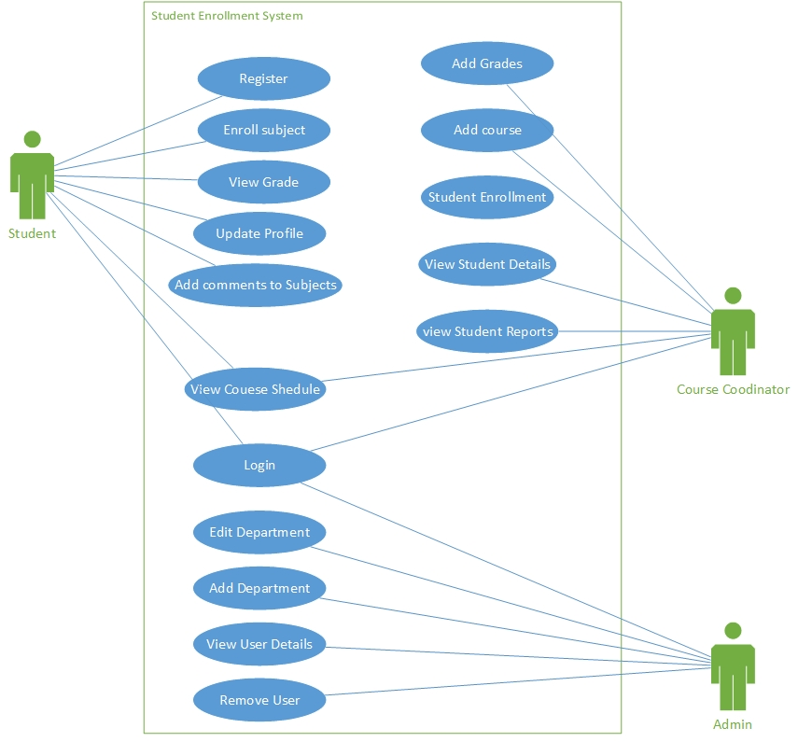
Use Case Diagram :

Slide 7
Modules Used :
User Management Module:
Responsible for user authentication and authorization.
Manages roles and permissions for administrators, instructors, and students.
Course Creation and Management Module:
Allows administrators to create, update, and organize course information.
Manages course schedules, syllabi, and other related details.
Enrollment Module:
Handles student enrollment processes, including registration and class capacity management.
Provides automated enrollment and waitlist functionalities.
4. Communication Module:
Centralized hub for announcements, discussion forums, and messaging.

Slide 8
Functionality performed by Project :
Login for admin
Forgot password for admin
Edit profile for admin
Logout Functionality
Dashboard for Admin User
Manage Course Manage Student
Adding new Course - Adding new Student
Edit the existing Course - Edit the existing Student
View details of the Course - View details of the Student
Reports
Report of all Course
Report of all Student

Slide 9
Technology used :
HTML : Page layout has been designed in HTML.
CSS : CSS has been used for all the designing part.
JavaScript : All the validation task and animations has been developed by JavaScript.
PHP : All the business and frontend logic has been implemented in PHP.
MySQL : MySQL database has been used as database for the project.

Slide 10
Conclusion & Future Scope :
The implementation of the Course Management System (CMS) has proven to be a transformative solution for educational institutions, addressing key challenges in course administration and significantly improving the overall learning experience. Through the integration of user-friendly interfaces, streamlined administrative processes, and enhanced communication channels, the CMS has become an essential tool for administrators, instructors, and students alike.
The success of the current Course Management System lays the foundation for future enhancements and expansions. The future scope of the CMS includes:
1. AI and Predictive Analytics
2. Enhanced Mobile Accessibility
3. Gamification and Interactive Learning
By continuously evolving and expanding the CMS, educational institutions can stay at the forefront of technological advancements, providing an adaptive and enriching learning experience for all stakeholders in the ever-changing landscape of education.

Slide 11
THANK YOU !

